Slide 1

Blood Analysis for Liver Diagnosis
Applied A.I. Solutions Development Program
Applied Math. Concepts For Machine Learning
Term Project
GROUP 6
Younes BENSASSI-NOUR - 101542854
Adnan SHAIKH - 101549676
Majed QARMOUT – 101565483
Supervised by: Dr. Reza MOSLEMI

Slide 2
Introduction
Data description
Data preprocessing
First models application
Grid search analysis
Feature selection
Conclusion

Slide 3
Introduction II. Data cleaning IV. First models application VI. Features selection
I. Data description III. Data preprocessing V. Grid search application Conclusion
Introduction
Data Source: https://archive.ics.uci.edu/dataset/571/hcv+data
Nature of Data: Laboratory values of blood donors and Hepatitis C patients
Classification Problem: Which phase is the patient with liver disease in?
Hepatitis C
Fibrosis
Cirrhosis

Slide 4
Introduction II. Data cleaning IV. First models application VI. Features selection
I. Data description III. Data preprocessing V. Grid search application Conclusion
Shape
615 samples
13 columns
Category (Target)
0=Blood Donor
0s=suspect Blood Donor
1=Hepatitis
2=Fibrosis
3=Cirrhosis
Male | Female
61% | 39%
 |  | Name | Quantity | Values
Target |  | Category | 1 | Categorical
Blood Features | Enzymes or Proteins | ALB / ALP / AST / BIL / CHE / CHOL / CREA / GGT / PROT | 9 | Numerical
Demographic Features |  | - Age - Sex | 2 | - Numerical - Categorical (f/m)

Slide 5
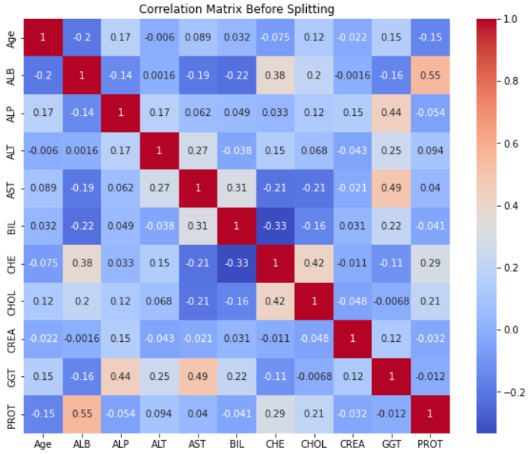
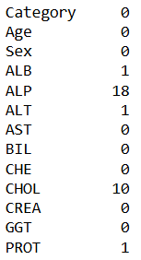
Introduction II. Data cleaning IV. First models application VI. Features selection
I. Data description III. Data preprocessing V. Grid search application Conclusion
Numerical Missing values: 40

Slide 6
Introduction II. Data cleaning IV. First models application VI. Features selection
I. Data description III. Data preprocessing V. Grid search application Conclusion
Column Transformer
Numerical Data
Categorical Data
Replace the missing data with the mean
Standardize the data
Replace the missing data with the most frequent
Apply the One-Hot-Encoder (‘Sex’ feature)
Split:
-Train
-Test
Fit the columns transformation

Slide 7
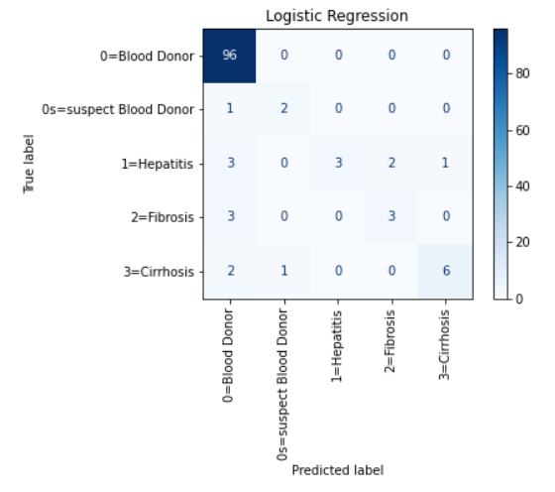
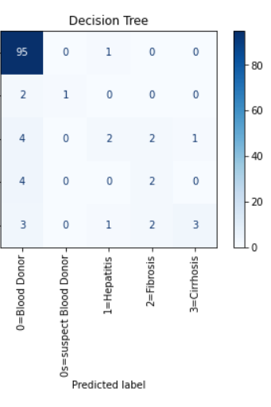
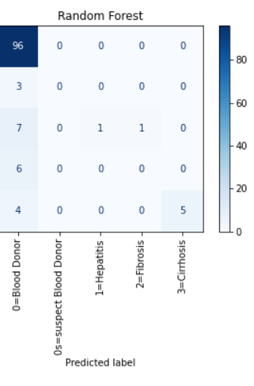
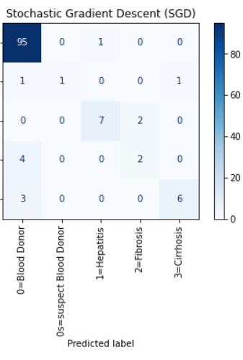
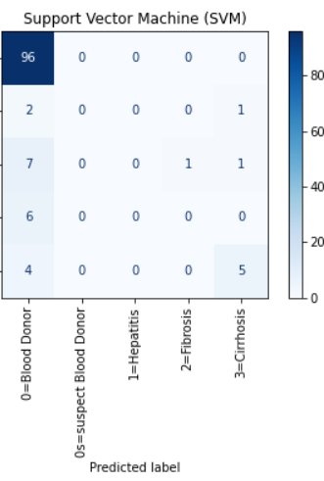
Introduction II. Data cleaning IV. First models application VI. Features selection
I. Data description III. Data preprocessing V. Grid search application Conclusion
Model | Logistic Regression | Decision Tree | Random Forest | SGD | SVM
Hyperparameters | random_state=42, max_iter=100 | Default parameters | n_estimators=10, max_depth=4 | max_iter=1000, tol=1e-3 (ie. Stopping criterion), random_state=42 | C= 1, gamma= 0.01, kernel= 'rbf', random_state=42
Accuracy | 0.8943089430 | 0.8373983739 | 0.8292682926 | 0.90243902439 | 0.82113821138

Slide 8
Introduction II. Data cleaning IV. First models application VI. Features selection
I. Data description III. Data preprocessing V. Grid search application Conclusion

Slide 9
Introduction II. Data cleaning IV. First models application VI. Features selection
I. Data description III. Data preprocessing V. Grid search application Conclusion

Slide 10
Introduction II. Data cleaning IV. First models application VI. Features selection
I. Data description III. Data preprocessing V. Grid search application Conclusion

Slide 11
Introduction II. Data cleaning IV. First models application VI. Features selection
I. Data description III. Data preprocessing V. Grid search application Conclusion
Features selectors:
Pearson
Chi-Square
Recursive Feature Elimination (RFE)
Logistic Regression (log-reg)
Random Forest (RF)
Light Gradient Boosting Machine (LGBM)

Slide 12
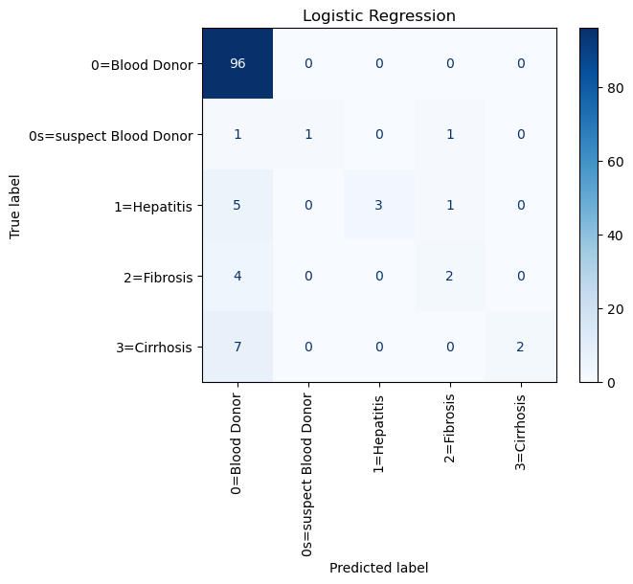
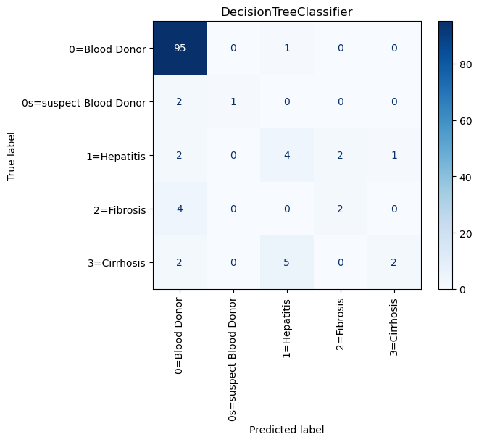
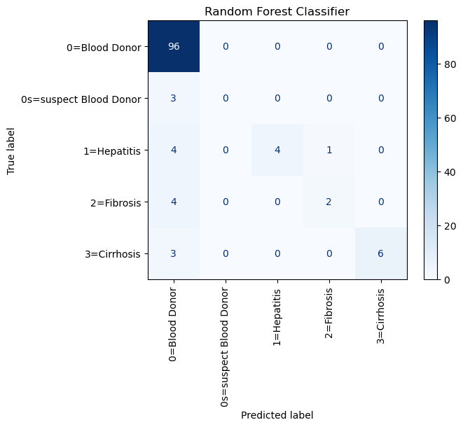
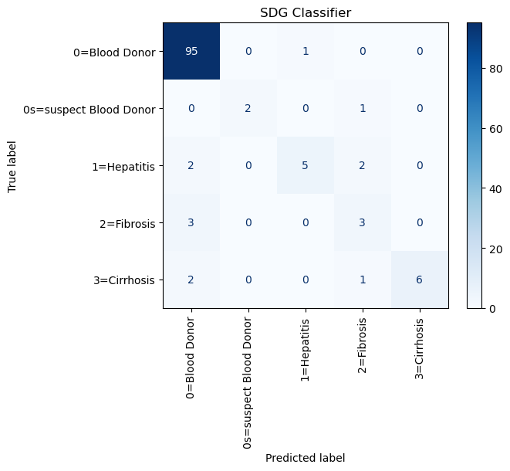
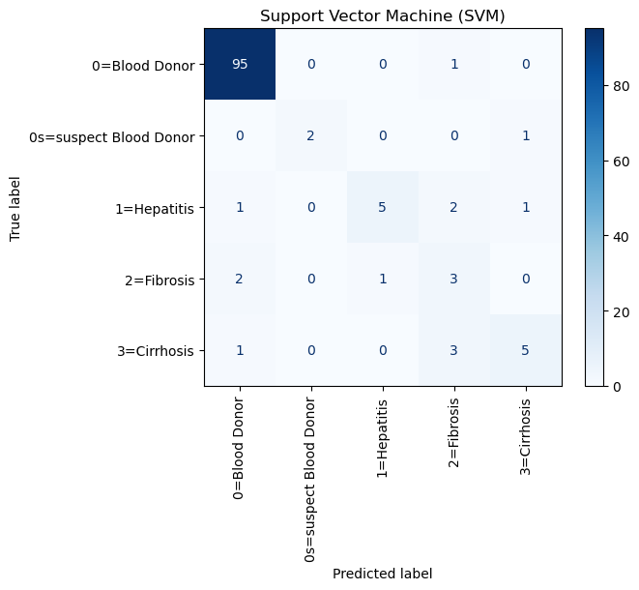
Introduction II. Data cleaning IV. First models application VI. Features selection
I. Data description III. Data preprocessing V. Grid search application Conclusion
 | Default | Grid search | No sex | No (sex – ggt) | No (sex – ggt – chol) | No (sex – ggt – chol - bil)
LRM | 89.43 | 89.43 | 88.61 | 89.46 | 85.37 | 86.99
DTM | 87.80 | 87.80 | 85.37 | 81.30 | 82.11 | 82.11
RFM | 86.18 | 85.37 | 85.37 | 86.18 | 86.99 | 86.18
SGDM | 86.99 | 87.80 | 89.43 | 83.74 | 83.74 | 83.74
SVMM | 86.99 | 86.99 | 89.43 | 83.74 | 88.62 | 85.37

Slide 13
Introduction II. Data cleaning IV. First models application VI. Features selection
I. Data description III. Data preprocessing V. Grid search application Conclusion

Slide 14
Introduction II. Data cleaning IV. First models application VI. Features selection
I. Data description III. Data preprocessing V. Grid search application Conclusion
What’s next:
- Remove unnecessary parameters to improve the grid search functionality
Improve model functionality through (max_iter, )
Retrieve more data as 600 is no where near enough
There could be more features that aren’t accounted for in this dataset

